Slide 1
T-20 World Cup 2022 Data Analysis

Slide 2
Problem Statement
The T-20 World Cup 2022 dataset provides a goldmine of cricket data, including detailed match
statistics, player performances, and game-changing events. Your mission is to unravel the stories hidden
within this dataset by:
1. Data Exploration: Delve into the dataset to uncover trends, patterns, and insights. Analyze the
performance of teams, players, and key events within the matches.
2. In-Depth Analysis: Examine player statistics, including runs, wickets, and over-by-over progress,
to understand the dynamics of the game.
3. Event Inference: Identify and analyze critical match events, such as boundaries, wickets, and
strategic moments. Uncover the factors that contribute to the success or downfall of a team.
4. Performance Evaluation: Evaluate individual and team performances, including standout
players, consistent run-scorers, and top wicket-takers. Discover what sets them apart.
5. Statistical Insights: Utilize statistical techniques to gain insights into team strategies, batting,
bowling, and match outcomes. Create visualizations that convey the story of the tournament.

Slide 3


Introduction to Libraries and Models
I am using libraries such as pandas and numpy for data manipulation and preprocessing, matplotlib and seaborn for data visualization.

Slide 4
Dataset Details
The dataset contains detailed information on T-20 World Cup 2022 matches. It includes:
- Match details: Match ID, names of the home and away teams, innings details, over-by-over progress.
- Player statistics: Runs, wickets, and other player-specific details.
- Match events: Boundaries, wickets, retired hurt scenarios, and more.
- Commentary text: Pre-match, in-match, and post-match commentary snippets.

Slide 5
Exploratory Data Analysis (EDA)
In this segment of exploratory data analysis (EDA) phase, where I had visually explored the relationships between different features Through visualizations such as correlation matrices, scatter plots, and histograms, we aim to identify patterns and insights within the data that may inform our modeling approach.
Team Performance Analysis:
Calculate the total runs scored and wickets taken by each team across all matches.
Analyze the win-loss ratio of each team.
Determine the average runs scored and wickets taken per match for each team.
Identify any trends in team performance over time.
Player Performance Analysis:
Calculate the total runs scored and wickets taken by each player.
Identify the top-performing batsmen and bowlers based on runs scored and wickets taken.
Analyze the batting and bowling averages of players.
Explore the strike rates of batsmen and economy rates of bowlers.

Slide 6
Key Events Analysis:
Identify the most common types of dismissals (e.g., caught, bowled, lbw) and their frequency.
Analyze the distribution of boundaries (fours and sixes) across matches and innings.
Explore the impact of key events (such as boundaries, wickets, and milestones) on match outcomes.
Match Analysis:
Analyze the distribution of match results (wins, losses, ties) across teams.
Identify any correlations between specific match conditions (e.g., home ground advantage, toss outcome) and match results.
Explore match duration and scoring patterns across innings.
Visualization and Interpretation:
Create visualizations such as bar charts, line plots, and heatmaps to represent trends and patterns in the data.
Interpret the findings to uncover insights about team and player performances, as well as the dynamics of T20 cricket matches.
Statistical Analysis:
Conduct statistical tests (e.g., t-tests, ANOVA) to compare the performance of different teams and players.
Determine the significance of relationships between variables (e.g., runs scored and match outcomes).

Slide 7
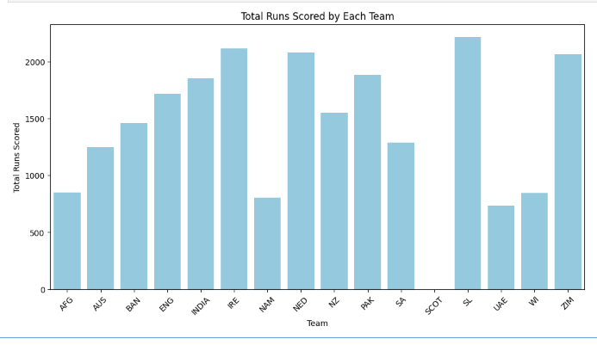
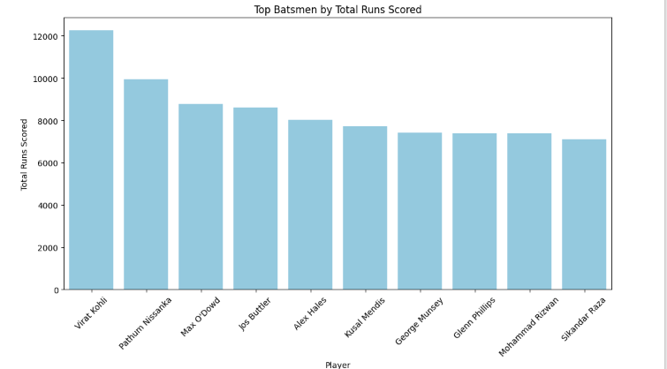

Slide 8
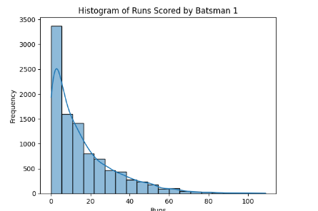
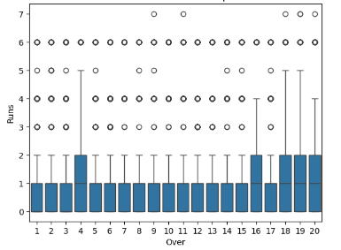
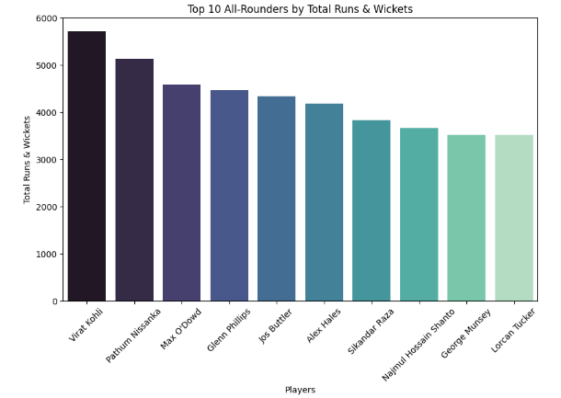

Slide 9
Conclusion
This project presents a thrilling opportunity to analyze real-world T-20 cricket data and draw meaningful
insights from it. By the end of this project, you'll have developed strong analytical skills, honed your data
analysis techniques, and have the ability to provide a comprehensive understanding of the T-20 World
Cup 2022.

Slide 10
References
https://www.kaggle.com
https://www.geeksforgeeks.org
https://numpy.org/
https://pandas.pydata.org/

